Slide 1

DevelopersDeck
"A Place for developers to learn and grow"

Slide 2
Guide: Dr Pragya Swami
Group 23
MEMBERS:
Yash Heeralal Santani 19BCE10069
Chitrankshi Rathour 19BCE10419
Gurshaan Singh Gill 19BCE10041
Jaishree Sharma 19BCE10307

Slide 3
Introduction
DevelopersDeck is a website for the use of developers.
It will connect developers from different domains to work together.
They can like, dislike, share and comment on the content according to their preferences same as a social media website.

Slide 4
Existing works and Limitations
There are some existing developers platform that are not feasible either due to security issues or no fixed dedicated servers. Some examples are:

Slide 5
Masterbranch:
Software developers showcase their projects and programming skills. It aggregates and analyzes projects from opensource software hostings and builds profiles out of all this information.
Limitations:
Developers cannot post any video or photos.
Along with explanation only code can be posted.
Users cannot send messages to each other.

Slide 6
HTML5 Rocks:
It is a site for developers dedicated to HTML5 where they can find resources, tutorials and demonstrations of the technology.
Limitations:
Only restricted to HTML5.
Very less number of users.

Slide 7
Proposed work and Methodology
DevelopersDeck is MERN Stack based.
MERN Stack comprises of 4 technologies namely:
MongoDB: Cross-platform Document-Oriented Database
Express: Back-End Framework:
React: Front-End Library
Node.js: JS Runtime Environment

Slide 8
Novelty of our project
Many platforms exist for a general interaction but there is no such platform for developers.
Therefore a site based on creating an environment for the developers to spread their work.
About 70% of web is working on php and it is not secured.
DevelopersDeck is not based on php and hence being more secure.

Slide 9
Real Time Usage
The purpose of this project is to provide a social network for developers.
Helps in minimizing the communication gap between developers.
No long delays for uploading contents.
Posting contents with better quality and no restrictions on size.
Provides clean and user-friendly interface to users.

Slide 10
Hardware and Software Requirements
Hardware Requirements:
Laptop with 256 MB RAM ,1 Gb hard drive space.
Software Requirements:
Web Browser: Google Chrome/Mozilla
Operating System: Windows XP/Windows 7
MongoDB, Express, React, Node.js

Slide 11
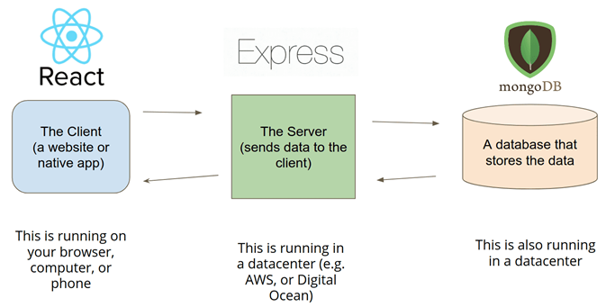
Overall System Architecture Diagram
It has Three-tier architecture diagram consisting of
Client Side
Server Side
Database

Slide 12
Literature review
No previous specific websites for the soul purpose of developers.
DevelopersDeck is a website for the use of developers.
Helps to post their work and view other developers.
Helps the developers to connect and work together.

Slide 13
Module Description
The whole project is divided into 6 Modules:​
Module 1: Home page
Module 2: ​Login
Module 3: Registration
Module 4: Profile
Module 5: Dashboard
Module 6: Posts ​

Slide 14
Module Description
1-The first module is the home screen. The home page lets the user to choose the options available and go through them according to the user’s need.
2-The second module consists of the login process. The user can login to his/her account with the username and password. The signed in users can access the website.

Slide 15
Module Description
Module 3: Registration process lets the user to Sign Up for the website by creating account using valid username and password.
Module 4: It consist of the User Profile. After the login process the user can use the profile page to view their information and edit the details.

Slide 16
Module Description
Module 5: Dashboard provides the user to go through the profiles of the other developers and get to know them.
Module 6: Posts screen allows the user to add a post and also view the posts of other developers. ​

Slide 17
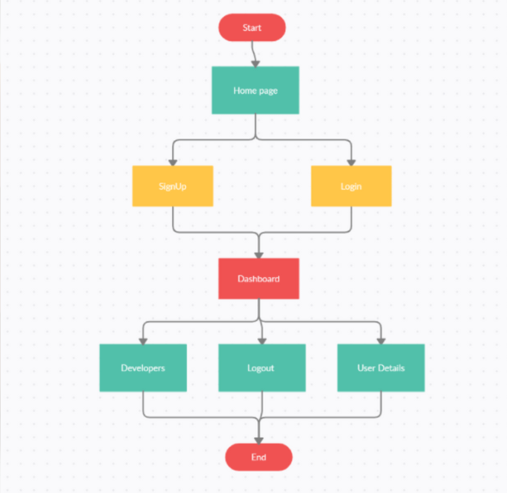
Module Work Flow Explanation

Slide 18
Implementation and Coding
The website is for the purpose of the developers.
It is implemented using the MERN Stack technology.
We have used MongoDB for database, Express for Back-End Framework, React for Front-End and Node.js.

Slide 19
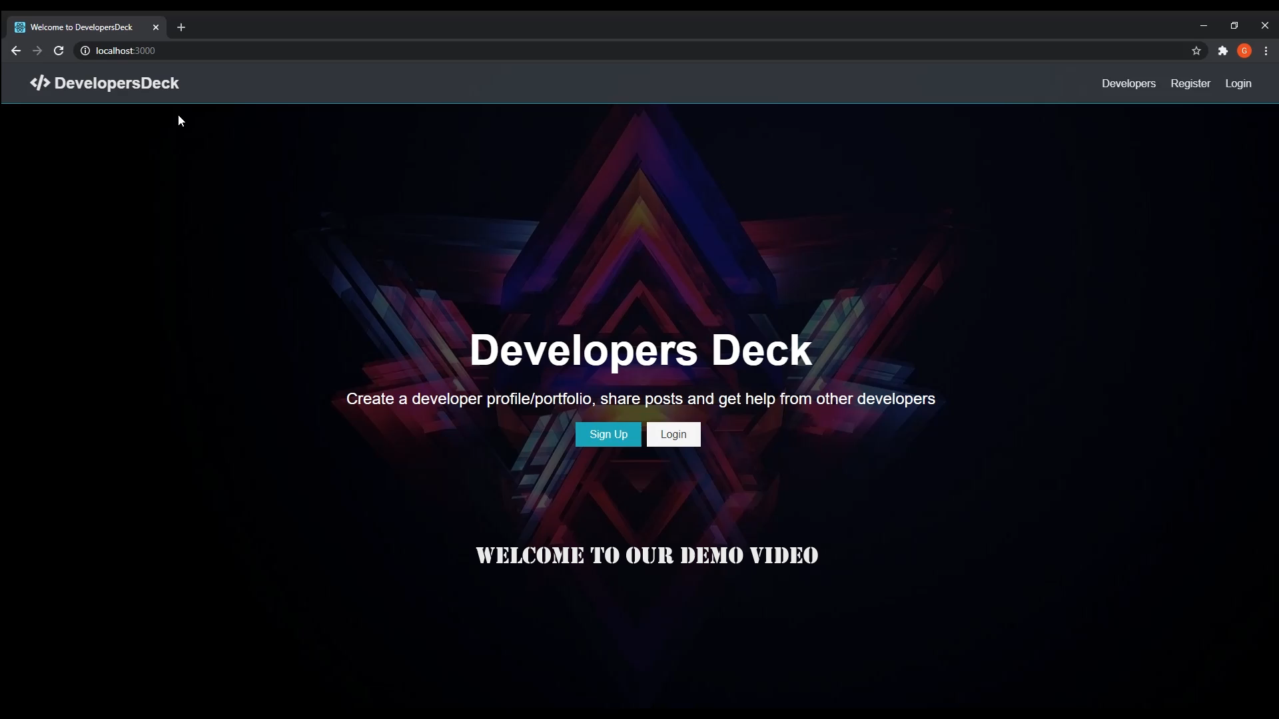
Demo Video

Slide 20
Snap Shot of the Project

Slide 21
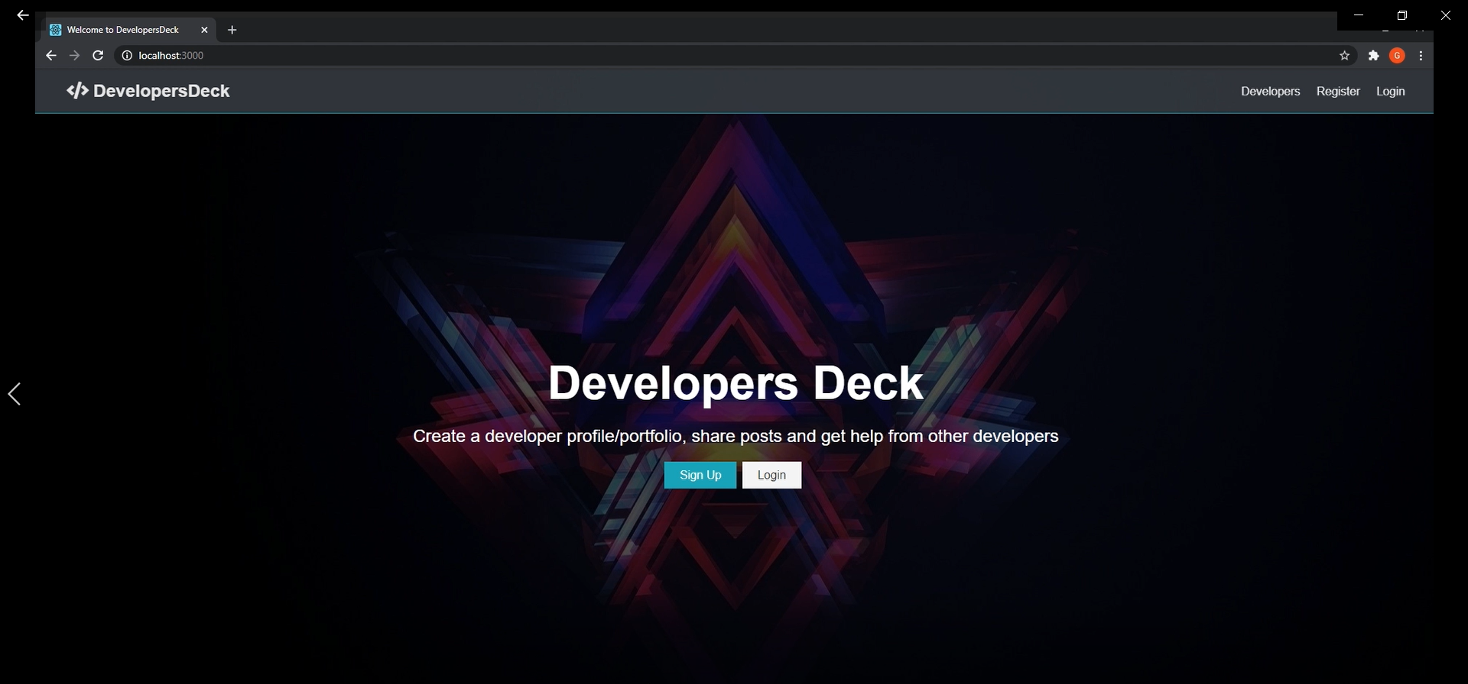
Home Screen

Slide 22
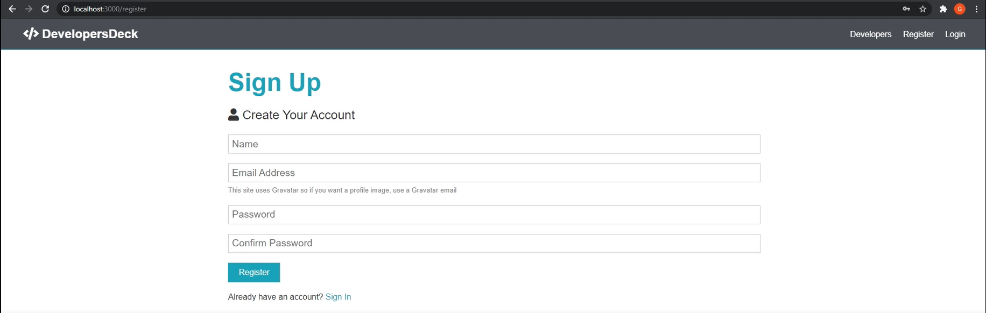
Sign Up Screen

Slide 23
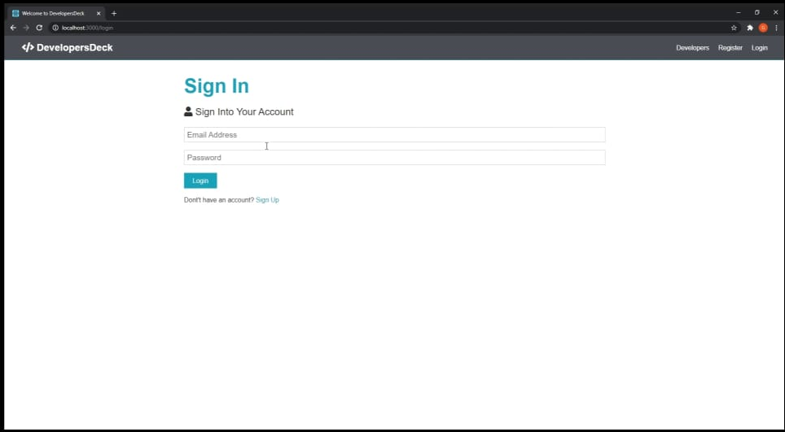
Login Screen

Slide 24
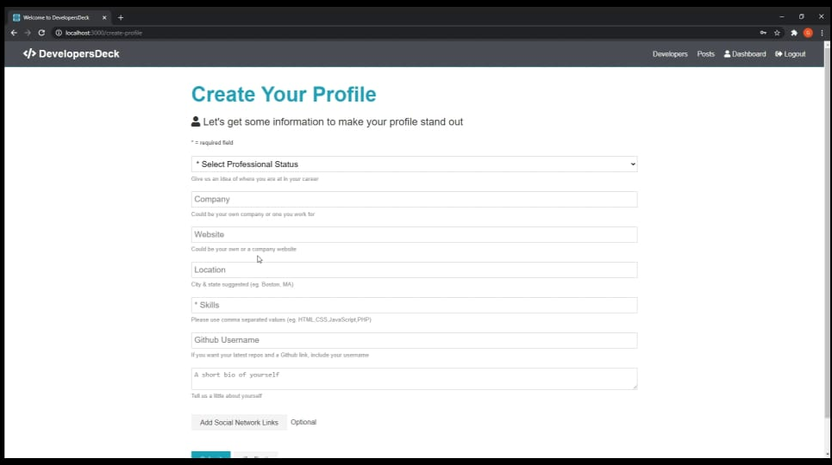
Editing/Creating Profile

Slide 25
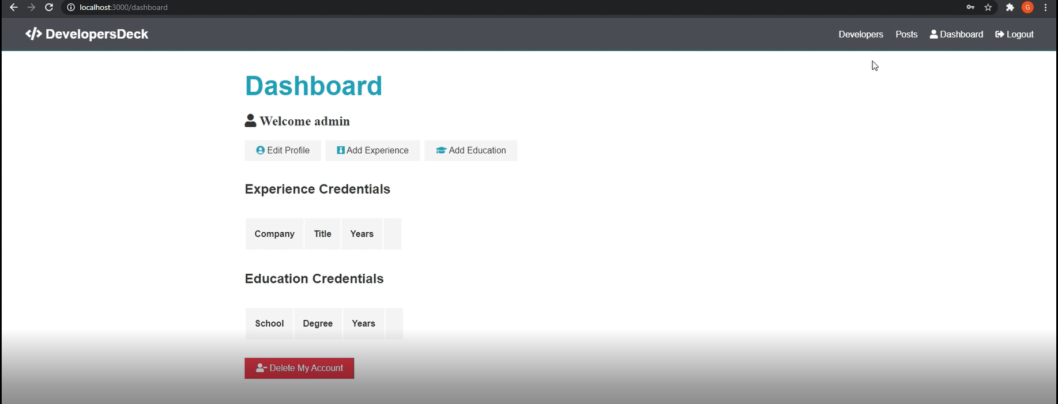
Profile Screen

Slide 26
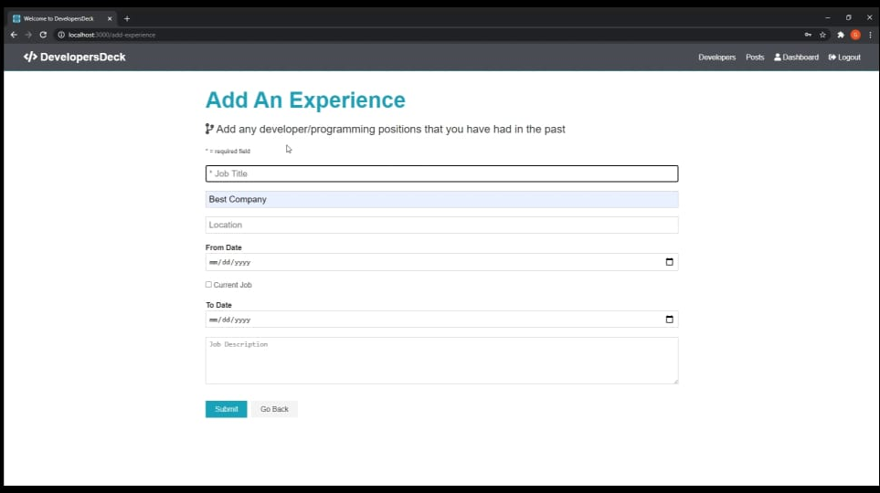
Adding Experience

Slide 27
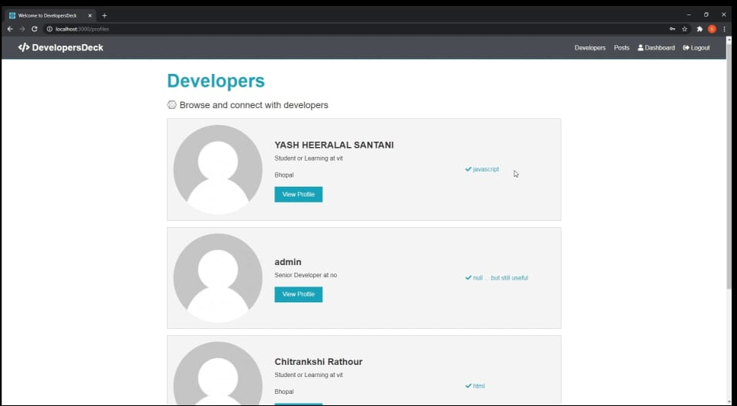
Dashboard

Slide 28
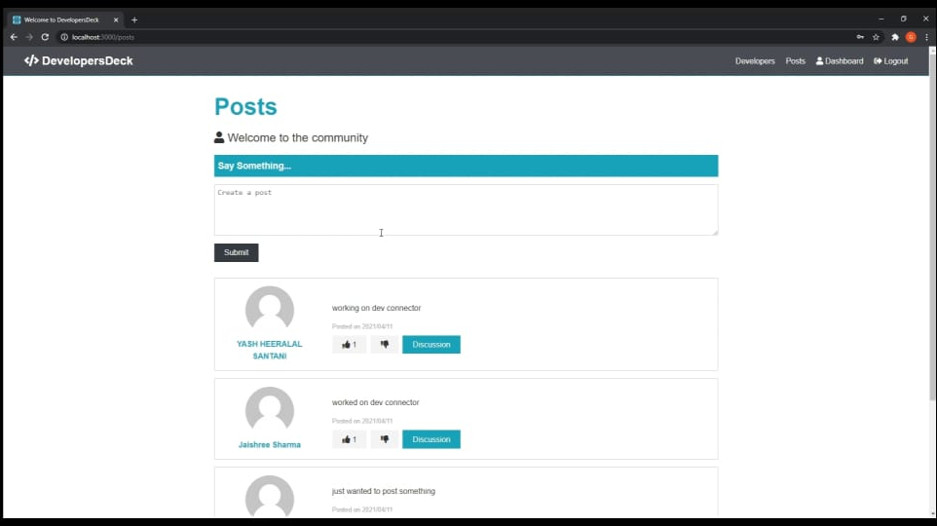
Posts

Slide 29
Testing
We’ve tested Developers Deck completely and analyzed its performance.
There are 53% of users abandon sites that take longer than three seconds to load therefore improvement in load performance is needed.
So, we’ve tested the HTTPS implementation for all pages and assets, and used the chrome task manager to compare our site against others for memory usage when loading the home page and using other site features

Slide 30
Result and Discussion
The user needs to input the username and password and can access the website.
The user needs create profile and add details like name, age, gender, etc.
The user can add educational details like school information and fill up their profile.
The user also needs to upload their experience for better connectivity.
At last the user can upload or view the posts of other developers.

Slide 31
Conclusion
At the end we have made an amazing website which will provide our user the things which we promised.​
As we promised, it will help the developers to connect and grow.
It is a place for the developers to learn and grow together.

Slide 32
ThankYou!!

